Slide 1

A
REPORT
ON
ONLINE BOOKSTORE
As a part M.Sc(IT & CA)
Year 2010-2011
Project Developed By:
Jalpesh Chhaya & Mahesh Gohil
Submitted To:
H.N.Shukla College Of IT & MGT
Rajkot

Slide 2
SYSTEM OVERVIEW
Tables :-
1 Category
2 Editorial Category
3 Editorials
4 Card Type
5 Item Table
6 Member Table
7 Order Table
Forms :-
1 Login Form
2 User Information form
3 Homepage
4 Search Result Form
5 Advanced Search Form
6 Display Category Wise Form
7 Registration Form
8 Shopping Cart
9 Administrator Menu
Member Form Books Form
Order form Categories Form
Editorial Category Editorials
Card Type

Slide 3

Category Table:

Slide 4

Card_Types Table:

Slide 5

Editorial Category Table:

Slide 6
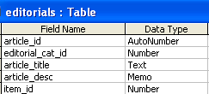
Editorials Table:

Slide 7
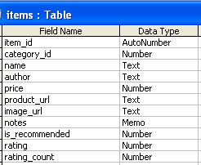
Item Table:

Slide 8
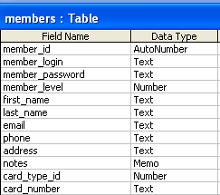
Member Table:

Slide 9
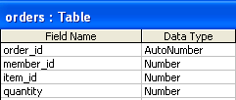
Order Table:

Slide 10
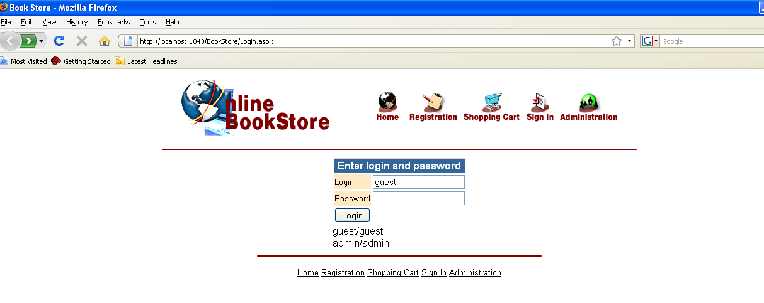
Login Form:

Slide 11
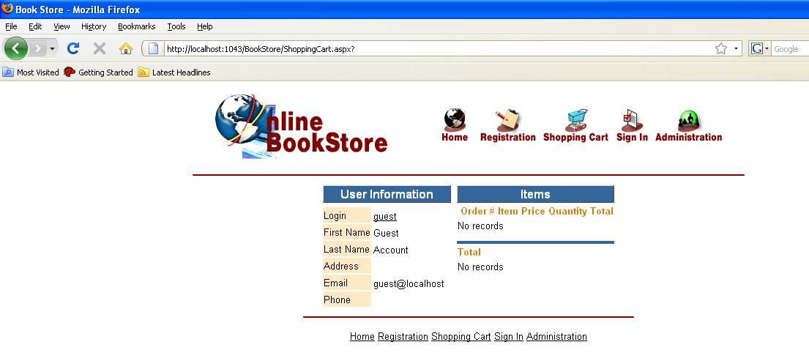
User Information:

Slide 12
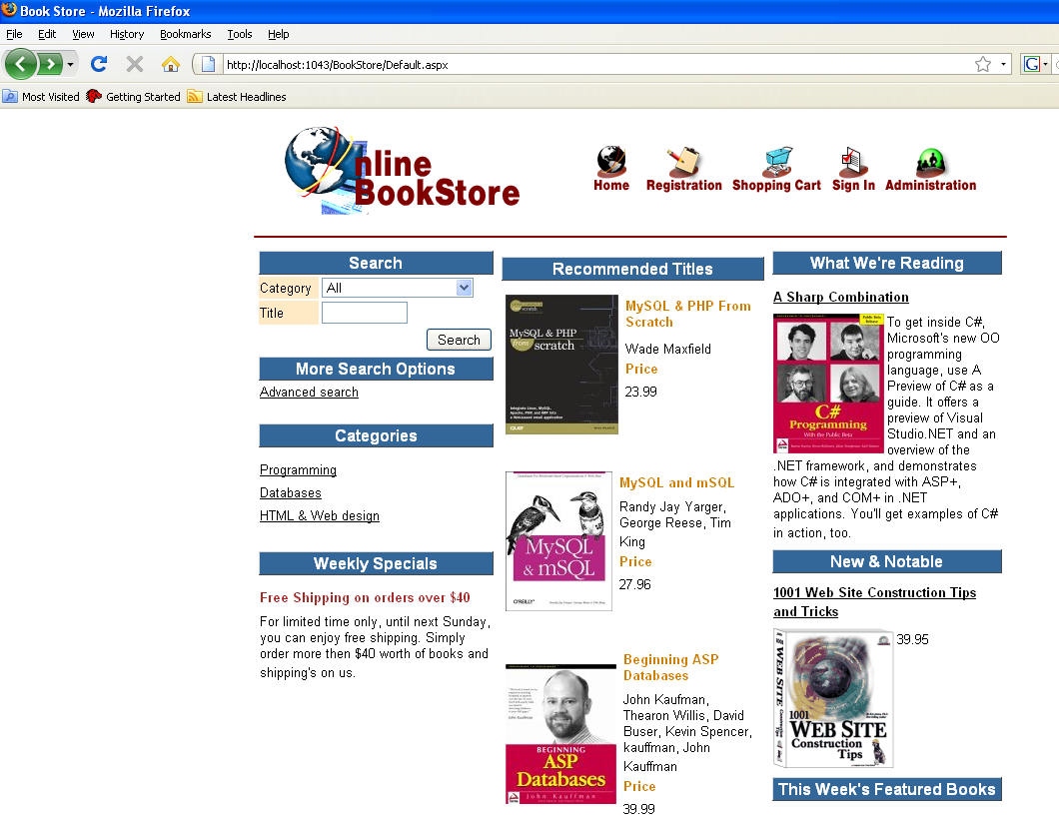
Home Page:

Slide 13
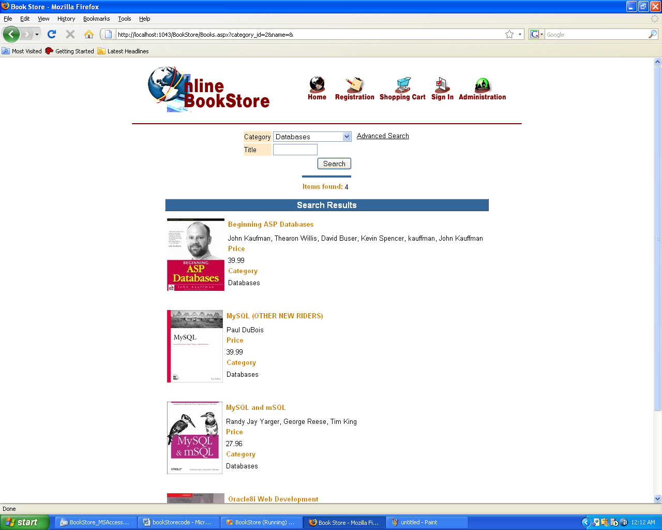
Search Result:

Slide 14
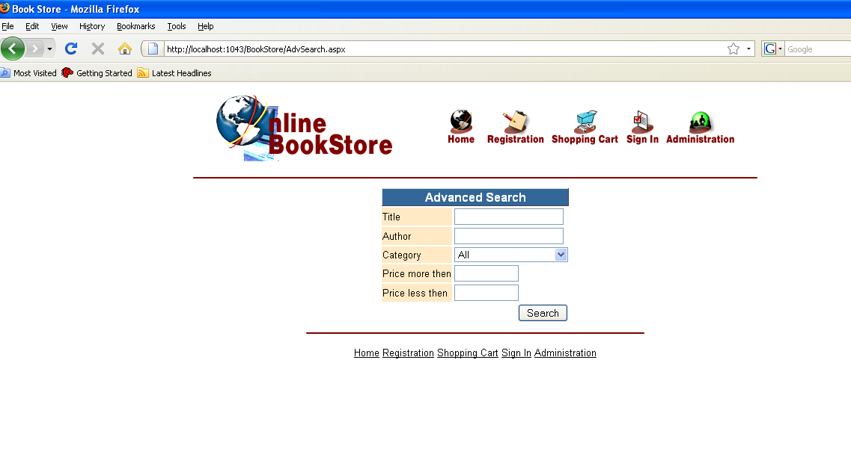
Advanced Search:

Slide 15
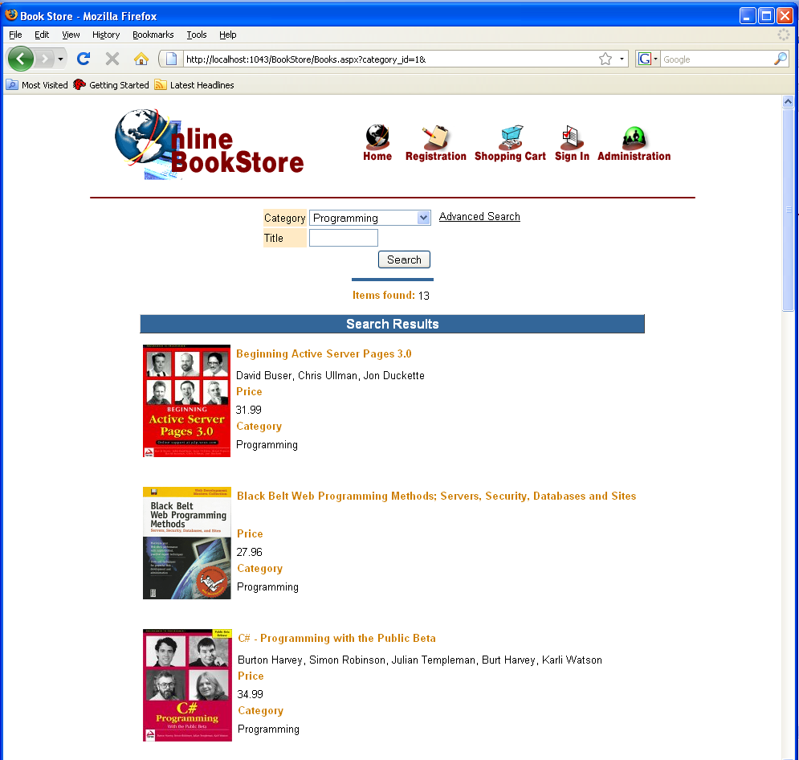
Display Category wise:

Slide 16
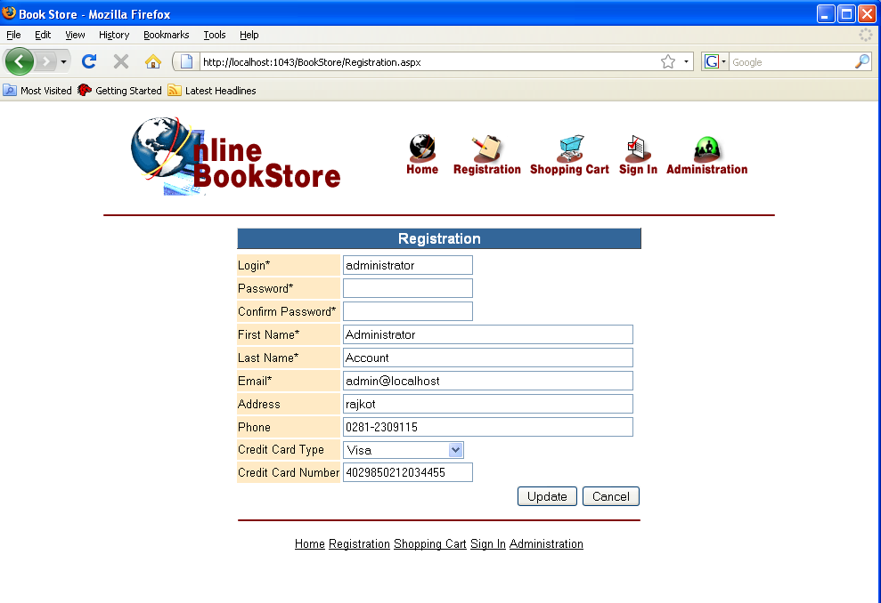
Registration Form:

Slide 17
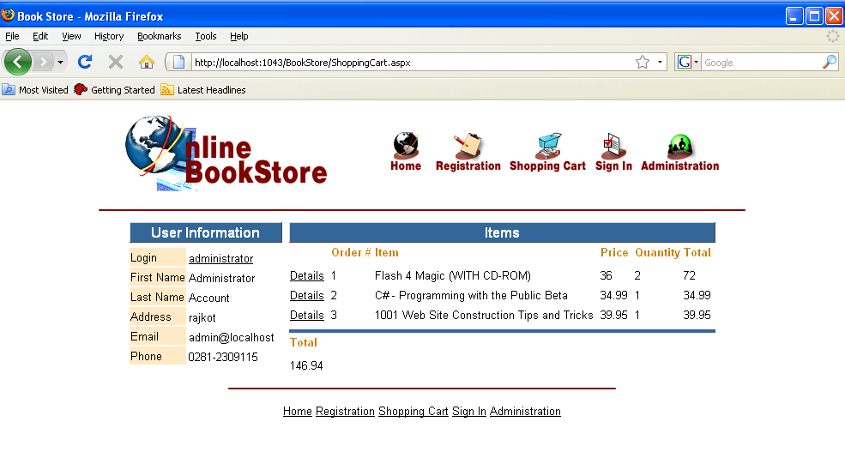
Shopping Cart:

Slide 18
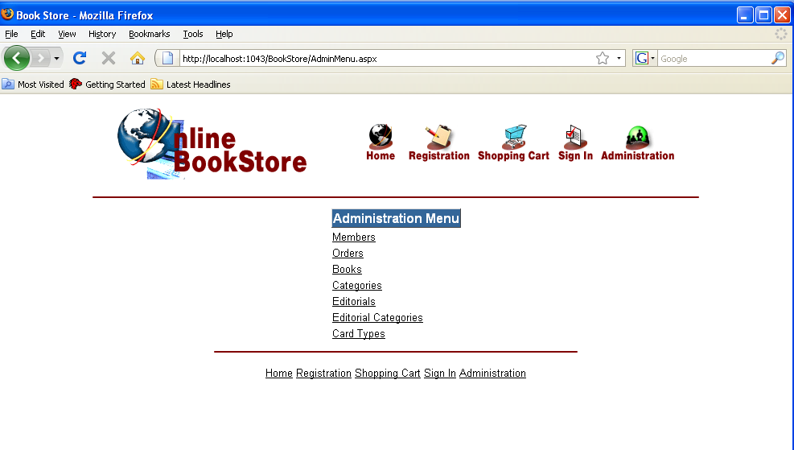
Administrator Menu:

Slide 19
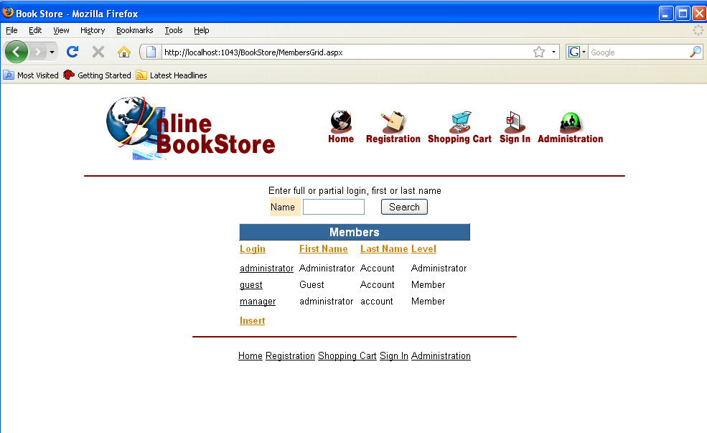
Add Member:

Slide 20
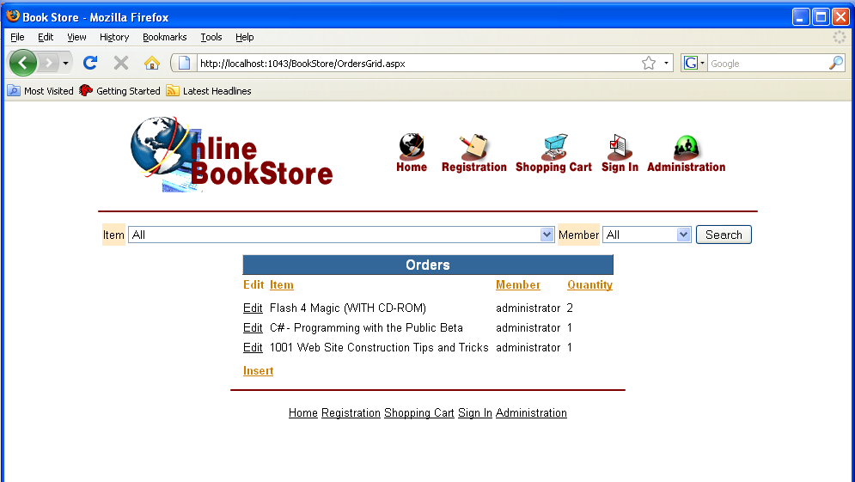
Order Details:

Slide 21
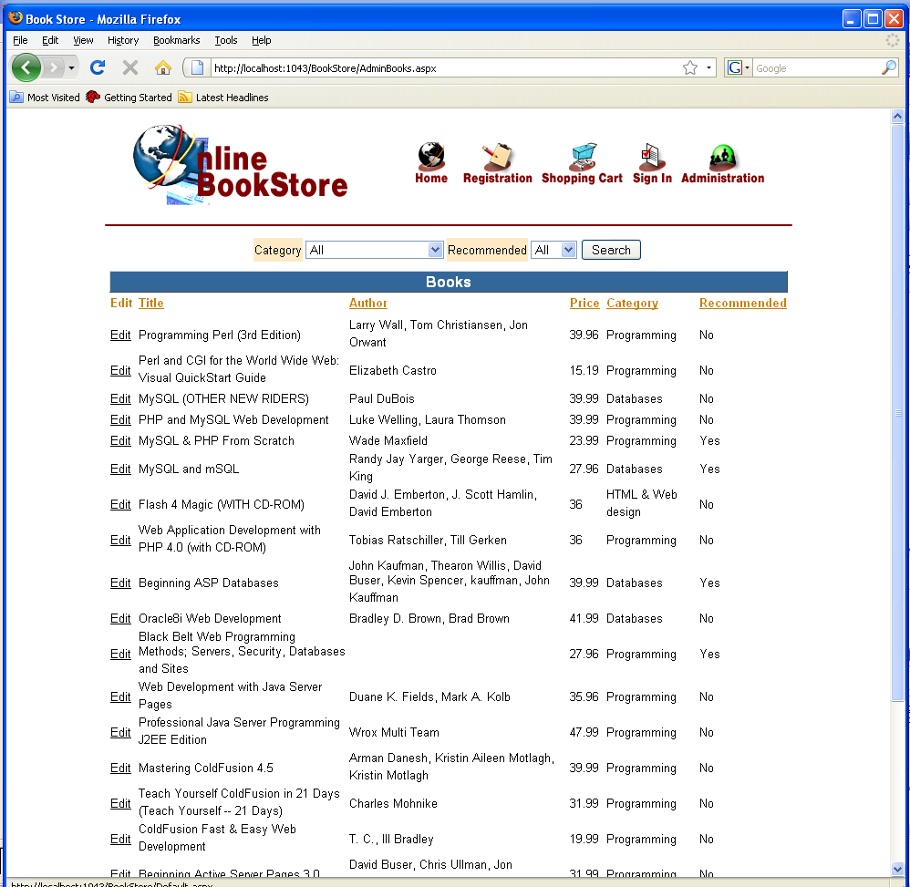
Book Information:

Slide 22
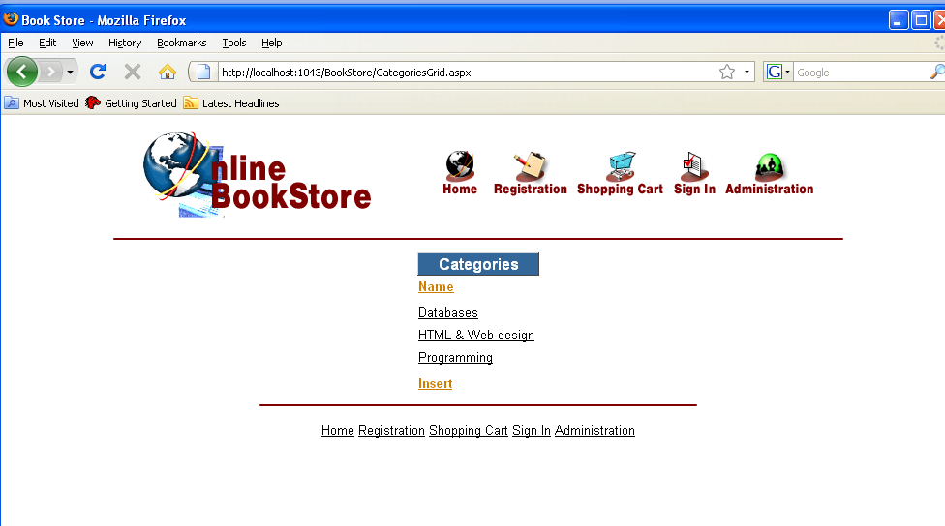
Categories:

Slide 23
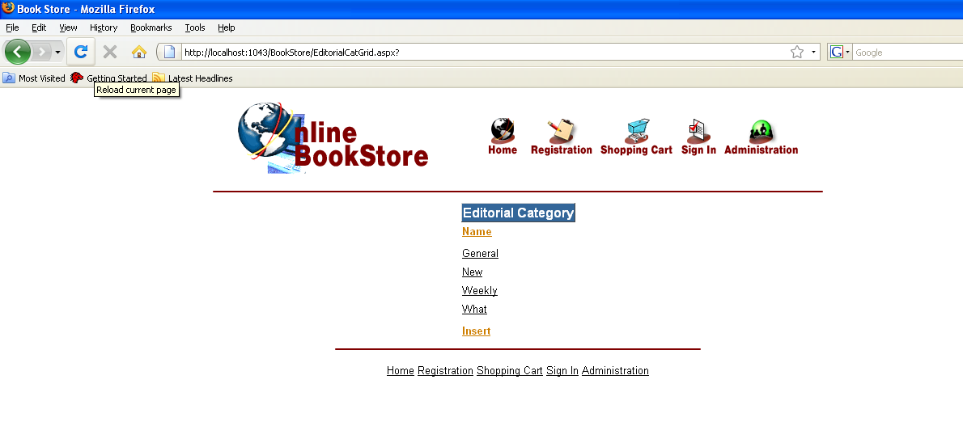
Editorial Category:

Slide 24
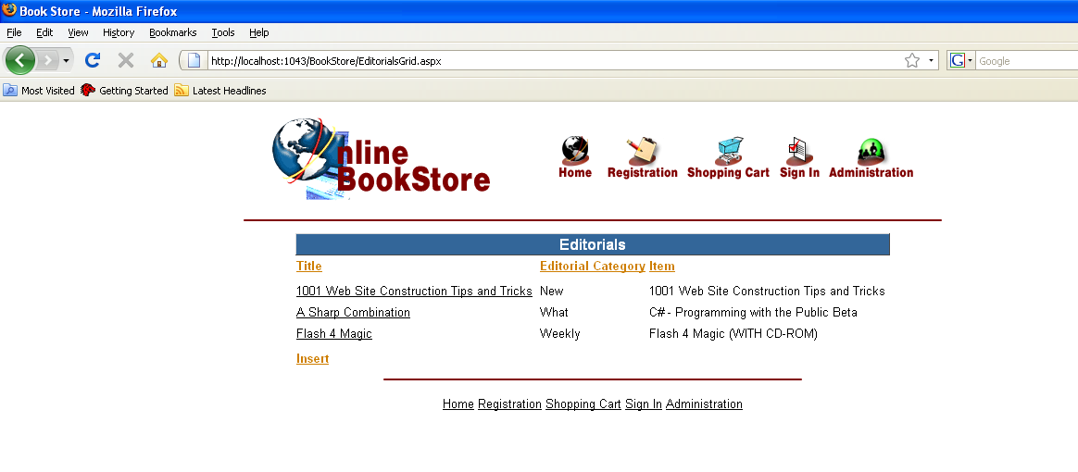
Editorials:

Slide 25
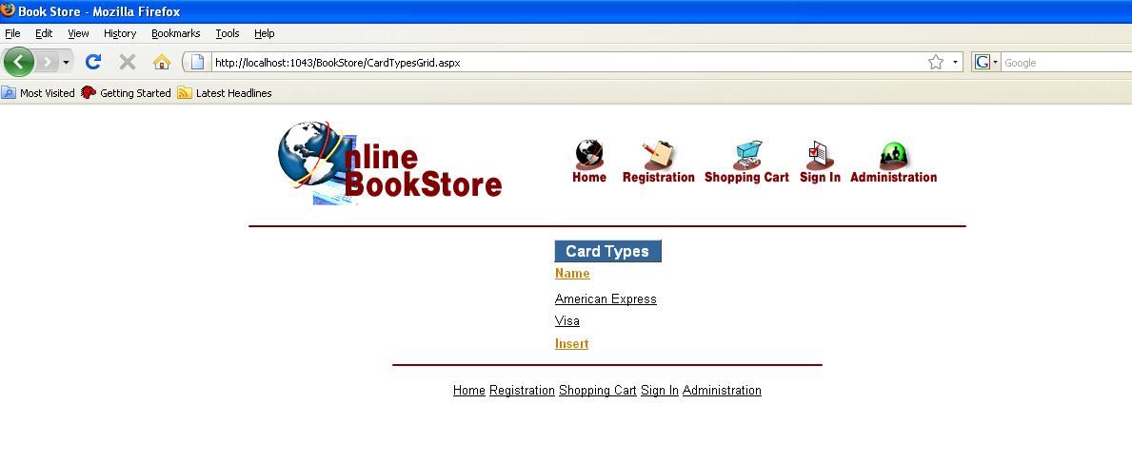
Card Type:

